Slide 1

Multiprocessor Synchronization
CSCI 1760
Transactional Memory
Lecture 24
December 2024
Maurice Herlihy
Brown University

Slide 2
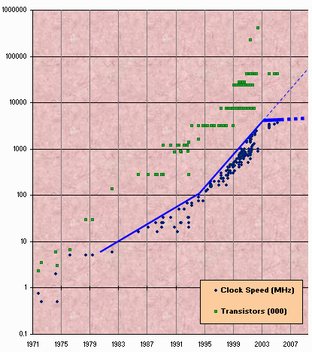
Moore’s Law Literally
Transistor count still rising
Clock speed flattening sharply
2
Notes:
2
Most of you have probably heard of Moore’s law, which states that the number of transistors on a chip tends to double about every two years. Moore’s law has been the engine of growth for our field, and the reason you can buy a laptop for a few thousand dollars that would have cost millions a decade earlier. The green dots on this graph show

Slide 3
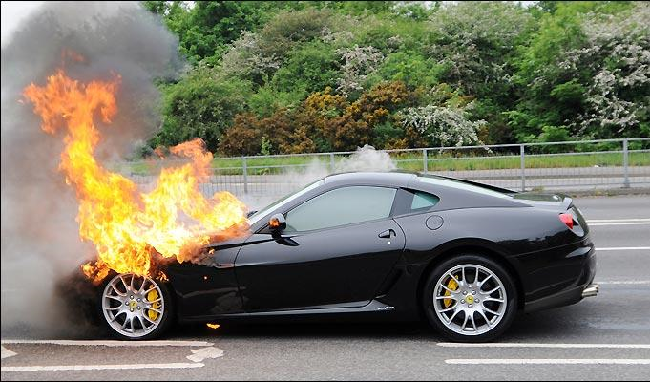
Moore’s Law for Dummies

Slide 4

Extinct: the Uniprocesor
cpu
memory
4
Notes:
4
Traditionally, we have had inexpensive single processor with an associated memory on a chip, which we call a uniprocessor.

Slide 5
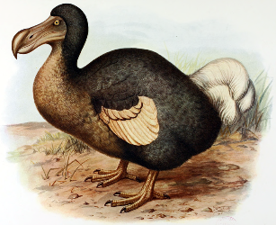
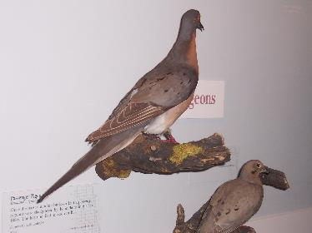
Extinct:
Shared Memory Multiprocessor
(SMP)
cache
cache
cache
Bus
Bus
shared memory
5
Notes:
5
And we had expensive multiprocessor chips in the enterprise, that is, in server farms, high performance computing centers and so on. The
Shared memory multiprocessor (SMP) consists of multiple CPUs connected by a bus or interconnect network to a shared memory.

Slide 6
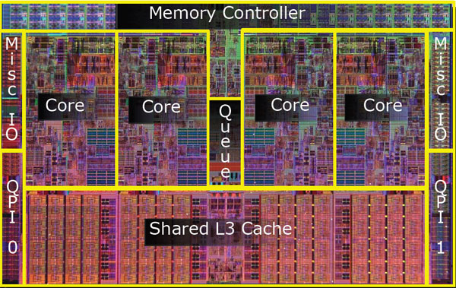
Meet the New Boss:
The Multicore Processor
(CMP)
All on the same chip
6
Notes:
6
The revolution we are going through is that the desktop is now becoming a multiprocessor also. We call this type of processor a system-on-a-chip or a multicore machine or a chip multiprocessor (CMP). The chip you see here is the Sun T2000 Niagara CMP that has 8 cores and shared cache and memory. We will learn about the Niagara in more detail later. It is the machine you will be using for your homework assignments.

Slide 7
Scaling before multicore
7x
3.6x
Speedup
1.8x
atomic {
x.remove(3);
y.add(3);
}
atomic {
x.remove(3);
y.add(3);
}
atomic {
x.remove(3);
y.add(3);
}
Code
Uniprocessor
Time: Moore’s law
Notes:
7
Recall the traditional scaling process for software: write it once, trust Intel to make the CPU faster to improve performance.

Slide 8
Ideal Multicore Scaling
7x
3.6x
Speedup
1.8x
Nope
atomic {
x.remove(3);
y.add(3);
}
atomic {
x.remove(3);
y.add(3);
}
atomic {
x.remove(3);
y.add(3);
}
atomic {
x.remove(3);
y.add(3);
}
atomic {
x.remove(3);
y.add(3);
}
atomic {
x.remove(3);
y.add(3);
}
atomic {
x.remove(3);
y.add(3);
}
atomic {
x.remove(3);
y.add(3);
}
atomic {
x.remove(3);
y.add(3);
}
atomic {
x.remove(3);
y.add(3);
}
Code
atomic {
x.remove(3);
y.add(3);
}
atomic {
x.remove(3);
y.add(3);
}
atomic {
x.remove(3);
y.add(3);
}
atomic {
x.remove(3);
y.add(3);
}
Multicore
Notes:
8
With multicores, we will have to parallelize the code to make software faster, and we cannot do this automatically (except in a limited way on the level of individual instructions).

Slide 9
Actual Multicore Scaling
2x
2.9x
1.8x
Speedup
atomic {
x.remove(3);
y.add(3);
}
atomic {
x.remove(3);
y.add(3);
}
atomic {
x.remove(3);
y.add(3);
}
atomic {
x.remove(3);
y.add(3);
}
atomic {
x.remove(3);
y.add(3);
}
atomic {
x.remove(3);
y.add(3);
}
atomic {
x.remove(3);
y.add(3);
}
atomic {
x.remove(3);
y.add(3);
}
Exploiting parallelism
requires expertise!
atomic {
x.remove(3);
y.add(3);
}
Code
atomic {
x.remove(3);
y.add(3);
}
atomic {
x.remove(3);
y.add(3);
}
atomic {
x.remove(3);
y.add(3);
}
atomic {
x.remove(3);
y.add(3);
}
atomic {
x.remove(3);
y.add(3);
}
Multicore
Notes:
9
This is because splitting the application up to utilize the cores is not simple, and coordination among the various code parts requires care.

Slide 10
Amdahl’s Law
1-thread execution time
Speedup =
n-thread execution time
Notes:
10
This kind of analysis is very important for concurrent computation.
The formula we need is called \emph{Amdahl's Law}.
It captures the notion that the extent to
which we can speed up any complex job (not just painting)
is limited by how much of the job must be executed sequentially.
Define the \emph{speedup} $S$ of a job to be the ratio between the
time it takes one processor to complete the job (as measured by a wall clock)
versus the time it takes $n$ concurrent processors to complete the same job.
\emph{Amdahl's Law} characterizes the maximum speedup $S$ that can be achieved by $n$
processors collaborating on an application where $p$ is the fraction of
the job that can be executed in parallel.
Assume, for simplicity,
that it takes (normalized) time 1 for a single processor to complete the job.
With $n$ concurrent processors, the parallel part takes time $p/n$ and the sequential part takes time $1-p$.
Overall, the parallelized computation takes time:
$$
1 - p + \frac{p}{n}
$$
Amdahl's Law says that the speedup, that is,
the ratio between the sequential (single-processor) time and the parallel time,
is:
$$
S = \frac{1}{1 - p + \frac{p}{n}}
$$
We show this in the next set of slides

Slide 11

Amdahl’s Law
$$\frac{1}{1−p+\frac{p}{n}}$$
Speedup=
Notes:
11
AVOID USING THE WORD “CODE”, P is not a fraction of the code but if the execution time of the solution algorithm. It could be that 5% of the code are executed in a loop and account for 90% of the execution time.

Slide 12
Amdahl’s Law
parallel fraction
$$\frac{1}{1−p+\frac{p}{n}}$$
Speedup=
Notes:
12
AVOID USING THE WORD “CODE”, P is not a fraction of the code but if the execution time of the solution algorithm. It could be that 5% of the code are executed in a loop and account for 90% of the execution time.

Slide 13
Amdahl’s Law
parallel fraction
$$\frac{1}{1−p+\frac{p}{n}}$$
Speedup=
Number of threads
Notes:
13
AVOID USING THE WORD “CODE”, P is not a fraction of the code but if the execution time of the solution algorithm. It could be that 5% of the code are executed in a loop and account for 90% of the execution time.

Slide 14
Amdahl’s Law
parallel fraction
$$\frac{1}{1−p+\frac{p}{n}}$$
Speedup=
Number of threads
Notes:
14
AVOID USING THE WORD “CODE”, P is not a fraction of the code but if the execution time of the solution algorithm. It could be that 5% of the code are executed in a loop and account for 90% of the execution time.

Slide 15
Amdahl’s Law
sequential fraction
parallel fraction
$$\frac{1}{1−p+\frac{p}{n}}$$
Speedup=
Number of threads
Notes:
15
AVOID USING THE WORD “CODE”, P is not a fraction of the code but if the execution time of the solution algorithm. It could be that 5% of the code are executed in a loop and account for 90% of the execution time.

Slide 16
Amdahl’s Law in Practice
Bad synchronization ruins everything

Slide 17
Example
Ten cores
60% concurrent, 40% sequential
How close to 10-fold speedup?
Speedup = 2.17
17
Notes:
17

Slide 18
Example
Ten cores
80% concurrent, 20% sequential
How close to 10-fold speedup?
Speedup = 3.57
18
Notes:
18

Slide 19
Example
Ten cores
90% concurrent, 10% sequential
How close to 10-fold speedup?
Speedup = 5.26
19
Notes:
19

Slide 20
Example
Ten cores
99% concurrent, 1% sequential
How close to 10-fold speedup?
Speedup = 9.17
20
Notes:
20

Slide 21
Example
You buy a 10-core machine …
Your application is:
99% concurrent
01% sequential
How close to a 10-fold speedup?
21
Notes:
21

Slide 22
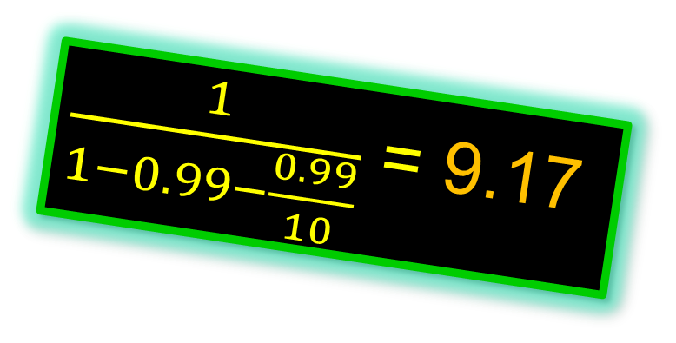
Example
You buy a 10-core machine …
Your application is:
99% concurrent
$\frac{1}{1−0.99−\frac{0.99}{10}}$ = 9.17
01% sequential
How close to a 10-fold speedup?
22
Notes:
22

Slide 23
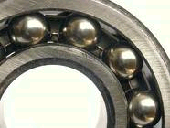
Diminishing Returns
This course was about the parts that
are hard to make concurrent …
but still have a big influence on speedup!
Notes:
With 25% sequential, cannot do more than

Slide 24
Locking
24
Notes:
24

Slide 25
Coarse-Grained Locking
Easily made correct …
But not scalable.
25
Notes:
25

Slide 26
Fine-Grained Locking
Can be very tricky …
26
Notes:
26

Slide 27
Locks do not tolerate faults
If a thread holding
a lock is delayed …
No one else can make progress
27
Notes:
27

Slide 28
Locking Relies on Conventions
Relation between …
Lock data and object data …
  /*
  * When a locked buffer is visible to the I/O layer
  * BH_Launder is set. This means before unlocking
  * we must clear BH_Launder,mb() on alpha and then
  * clear BH_Lock, so no reader can see BH_Launder set
  * on an unlocked buffer and then risk to deadlock.
  */
Actual comment from Linux Kernel
(hat tip: Bradley Kuszmaul)
Exists only in programmer’s mind

Slide 29
Simple Problems are hard
enq(x)
double-ended queue
enq(y)
No interference if ends “far apart”
Interference OK if queue is small
Clean solution is publishable result:
[Michael & Scott PODC 97]
29
Notes:
29

Slide 30
Locks do not compose
Transfer item from one queue to another
Must be atomic :
No duplicate or missing items
30
Notes:
30

Slide 31
Locks do not compose
Lock source
Unlock source & target
Lock target
31
Notes:
31

Slide 32
Locks do not compose
Lock source
Methods cannot provide internal synchronization
Unlock source & target
Objects must expose locking protocols to clients
Lock target
Clients must devise and follow protocols
Abstraction broken!
32
Notes:
32

Slide 33
Monitor Wait and Signal
Empty
zzz
buffer
Yes!
If buffer is empty,
wait for item to show up
33
Notes:
33

Slide 34
Monitor Wait and Signal do not Compose
empty
empty
zzz…
Wait for either?
34
Notes:
34

Slide 35

The Transactional Manifesto
Much modern programming practice inadequate for multicore world
Agenda
  Replace locking with a transactional API
  Design languages and libraries
  Implement efficient runtime systems
35

Slide 36
Road Map
Transactions vs Locks
Hardware Transactional Memory
Using Transactional Memory
Transactions with Locks?
Research Questions

Slide 37
Road Map
Transactions vs Locks
Hardware Transactional Memory
Using Transactional Memory
Transactions with Locks?
Research Questions

Slide 38
Transactions
Block of code ….
Atomic: appears to happen instantaneously
Serializable: all appear to happen in one-at-a-time order
Commit: takes effect (atomically)
Abort: has no effect (typically restarted)
38

Slide 39

Atomic blocks
atomic {
x.remove(3);
y.add(3);
}
atomic {
y = null;
}
39

Slide 40
Atomic blocks
atomic {
x.remove(3);
y.add(3);
}
atomic {
y = null;
}
Safe
(no data race)
40

Slide 41
A Double-Ended Queue
public void LeftEnq(item x) {
Qnode q = new Qnode(x);
q.left = left;
left.right = q;
left = q;
}
Write sequential Code
41
Notes:
41

Slide 42
A Double-Ended Queue
public void LeftEnq(item x)
atomic {
Qnode q = new Qnode(x);
q.left = left;
left.right = q;
left = q;
}
}
Enclose in atomic block
42

Slide 43

Warning
Not always this simple!
Conditional waits?
False conflicts?
Resource limits?
Better problems to have …
43

Slide 44
Composition?
44
Notes:
44

Slide 45
Composition?
public void Transfer(Queue<T> q1, q2)
{
atomic {
T x = q1.deq();
q2.enq(x);
}
}
Trivial or what?
45
Notes:
45

Slide 46
Conditional Waiting
public T LeftDeq() {
atomic {
if (left == null)
retry;
…
}
}
Roll back transaction and restart when something changes
46

Slide 47
Composable Conditional Waiting
atomic {
x = q1.deq();
} orElse {
x = q2.deq();
}
Run 1st method. If it retries …
Run 2nd method. If it retries …
Entire statement retries
47

Slide 48
Road Map
Transactions vs Locks
Hardware Transactional Memory
Using Transactional Memory
Transactions with Locks?
Research Questions

Slide 49


Hardware Transactional Memory
Exploit standard cache coherence
Detect synchronization conflicts …
Invalidate cached copies of data.
49
49
Notes:
49
Original TM proposal by Herlihy and Moss 1993…

Slide 50
Standard Cache Coherence
cache
cache
cache
Bus
memory
Notes:
We are going to do yet another review of multiprocessor architecture.

Slide 51
Standard Cache Coherence
Random access memory (10s of cycles)
cache
cache
cache
Bus
memory
Notes:
We are going to do yet another review of multiprocessor architecture.

Slide 52
Standard Cache Coherence
Shared Bus
  Broadcast medium
  One broadcaster at a time
  Processors and memory all “snoop”
cache
cache
cache
Bus
memory
Notes:
We are going to do yet another review of multiprocessor architecture.

Slide 53
Standard Cache Coherence
Per-Processor Caches
  Small
  Fast: 1 or 2 cycles
  Address & state information
cache
cache
cache
Bus
memory
Notes:
We are going to do yet another review of multiprocessor architecture.

Slide 54
Processor issues load
load x
cache
cache
cache
Bus
Bus
memory
data
Notes:
We are going to do yet another review of multiprocessor architecture.

Slide 55
Processor issues load
load x
E
cache
cache
cache
Bus
Bus
memory
data
data
Notes:
We are going to do yet another review of multiprocessor architecture.

Slide 56
Another processor issues load
Load x
E
cache
cache
data
cache
cache
Bus
Bus
memory
data
Notes:
We are going to do yet another review of multiprocessor architecture.

Slide 57
Another processor issues load
Load x
E
cache
cache
data
cache
cache
Bus
Bus
memory
data
Notes:
We are going to do yet another review of multiprocessor architecture.

Slide 58
Other processor responds
Got it
S
S
E
data
data
cache
cache
Bus
Bus
memory
data
Notes:
When the second processor asks for x, the first one, who is snooping on the bus, responds with the data. (It can respond faster than the memory). Both processors mark that cache line as shared.

Slide 59
Modify Cached Data
S
S
data
data
data
cache
Bus
memory
data

Slide 60
Invalidate everyone else’s cached data
Invalidate x
S
S
M
I
data
data
cache
cache
Bus
Bus
memory
data

Slide 61
Invalidate everyone else’s cached data
cache
data
cache
Bus
This cache acquires write permission
memory
data
Notes:
From this point on, the red processor can update that data value without causing any bus traffic, because it knows that it has the only cached copy. This is much more efficient than a write-through cache because it produces much less bus traffic.

Slide 62
Invalidate everyone else’s cached data
Other caches lose read permission
cache
data
cache
Bus
This cache acquires write permission
memory
data
Notes:
From this point on, the red processor can update that data value without causing any bus traffic, because it knows that it has the only cached copy. This is much more efficient than a write-through cache because it produces much less bus traffic.

Slide 63
Invalidate everyone else’s cached data
Memory provides data only if not present in any cache, so no need to change it now (expensive)
cache
data
cache
Bus
memory
data
Notes:
Finally, there is no need to update memory until the processor wants to use that cache space for something else. Any other processor that asks for the data will get it from the red processor.

Slide 64
Hardware Transactional Memory
read
active
T
data
caches
Interconnect
data
memory
data
64
64
Notes:
64

Slide 65
Hardware Transactional Memory
read
active
active
T
T
data
data
caches
data
data
memory
65
65
Notes:
65

Slide 66
Hardware Transactional Memory
active
committed
active
T
T
S
caches
data
data
data
memory
66
66
Notes:
66

Slide 67
Hardware Transactional Memory
write
committed
active
T
D
caches
memory
67
67
Notes:
67

Slide 68
Rewind
write
aborted
active
active
T
D
T
caches
memory
68
68
Notes:
68

Slide 69
Rewind
At Commit point …
No cache conflicts? We win.
Mark transactional cache entries ….
Was: read-only, Now: valid
Was: modified, Now: dirty
(will be written back)
That’s (almost) everything!
69
69
Notes:
69

Slide 70
Road Map
Transactions vs Locks
Hardware Transactional Memory
Using Transactional Memory
Transactions with Locks?
Research Questions

Slide 71
Hardware Transactional Memory (HTM)
IBM’s Blue Gene/Q & System Z & Power8
Intel’s TSX extensions
71

Slide 72
Intel TSX
if (_xbegin() == _XBEGIN_STARTED) {
speculative code
_xend()
} else {
abort handler
}

Slide 73
Intel TSX
if (_xbegin() == _XBEGIN_STARTED) {
speculative code
_xend()
} else {
abort handler
}
start a speculative transaction

Slide 74
Intel TSX
if (_xbegin() == _XBEGIN_STARTED) {
speculative code
_xend()
} else {
abort handler
}
If you see this, you are inside a transaction

Slide 75
Intel TSX
if (_xbegin() == _XBEGIN_STARTED) {
speculative code
_xend()
} else {
abort handler
}
If you see anything else, your transaction aborted

Slide 76
Intel TSX
if (_xbegin() == _XBEGIN_STARTED) {
speculative code
_xend()
} else {
abort handler
}
you could retry the transaction, or take an alternative path

Slide 77
Abort Codes
if (_xbegin() == _XBEGIN_STARTED) {
speculative code
} else if (status & _XABORT_EXPLICIT) {
aborted by user code
} else if (status & _XABORT_CONFLICT) {
read-write conflict
} else if (status & _XABORT_CAPACITY) {
cache overflow
} else {
…
}

Slide 78
Abort Codes
if (_xbegin() == _XBEGIN_STARTED) {
speculative code
} else if (status & _XABORT_EXPLICIT) {
aborted by user code
} else if (status & _XABORT_CONFLICT) {
read-write conflict
} else if (status & _XABORT_CAPACITY) {
cache overflow
} else {
…
}
speculative code can abort explicitly

Slide 79
Abort Codes
if (_xbegin() == _XBEGIN_STARTED) {
speculative code
} else if (status & _XABORT_EXPLICIT) {
aborted by user code
} else if (status & _XABORT_CONFLICT) {
read-write conflict
} else if (status & _XABORT_CAPACITY) {
cache overflow
} else {
…
}
synchronization conflict
(should probably retry)

Slide 80
Abort Codes
if (_xbegin() == _XBEGIN_STARTED) {
speculative code
} else if (status & _XABORT_EXPLICIT) {
aborted by user code
} else if (status & _XABORT_CONFLICT) {
read-write conflict
} else if (status & _XABORT_CAPACITY) {
cache overflow
} else {
…
}
read/write set too big (probably don’t retry)

Slide 81
Abort Codes
if (_xbegin() == _XBEGIN_STARTED) {
speculative code
} else if (status & _XABORT_EXPLICIT) {
aborted by user code
} else if (status & _XABORT_CONFLICT) {
read-write conflict
} else if (status & _XABORT_CAPACITY) {
cache overflow
} else {
…
}
other abort codes …

Slide 82
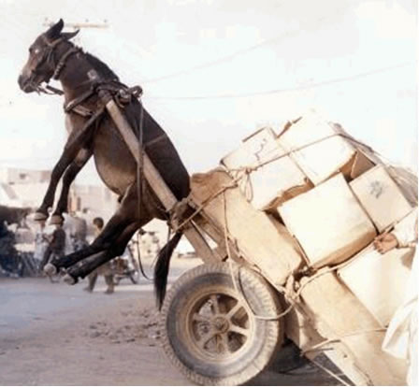
Transaction too big?
Transaction aborts if data set overflows caches, internal buffers

Slide 83
Transaction too slow?
Transaction aborts on timer interrupt

Slide 84

Just not in the mood?
Many other reasons: TLB miss, illegal instruction, page fault …

Slide 85

Hybrid Transactional Memory

Slide 86
Hybrid Transactional Memory
if (_xbegin() == _XBEGIN_STARTED) {
read lock state
if (lock taken) _xabort();
work;
_xend()
} else {
lock->lock();
work;
lock->unlock();
}

Slide 87
Hybrid Transactional Memory
if (_xbegin() == _XBEGIN_STARTED) {
read lock state
if (lock taken) _xabort();
work;
_xend()
} else {
lock->lock();
work;
lock->unlock();
}
reading lock ensures that transaction will abort if another thread acquires lock

Slide 88
Hybrid Transactional Memory
if (_xbegin() == _XBEGIN_STARTED) {
read lock state
if (lock taken) _xabort();
work;
_xend()
} else {
lock->lock();
work;
lock->unlock();
}
abort if another thread has acquired lock

Slide 89
Hybrid Transactional Memory
on abort, acquire lock & do work
(aborts other speculative txns)
if (_xbegin() == _XBEGIN_STARTED) {
read lock state
if (lock taken) _xabort();
work;
_xend()
} else {
lock->lock();
work;
lock->unlock();
}

Slide 90
Lock Elision
<HLE acquire prefix> lock();
do work;
<HLE release prefix> unlock()
90

Slide 91
Lock Elision
<HLE acquire prefix> lock();
do work;
<HLE release prefix> unlock()
first time around,
read lock and
execute speculatively
91

Slide 92
Lock Elision
<HLE acquire prefix> lock();
do work;
<HLE release prefix> unlock()
if speculation fails,
acquire the lock
92

Slide 93
Lock Elision
<HLE acquire prefix> lock();
do work;
<HLE release prefix> unlock()
Supported by Intel TSX
Can speed up legacy code!
93

Slide 94

Lock Teleportation

Slide 95
Hand-over-hand Locking
a
b
c

Slide 96
Hand-over-hand Locking
a
b
c

Slide 97
Hand-over-hand Locking
a
b
c

Slide 98
Hand-over-hand Locking
a
b
c

Slide 99
Removing a Node
a
b
c
d
remove(b)
99
Notes:
99

Slide 100
Removing a Node
a
b
c
d
remove(b)
Notes:
Here is a naive approach to removing a node. Each thread locks the node being examined and its predecessor.

Slide 101
Removing a Node
a
b
c
d

Slide 102
Lock Teleportation
read transaction
a
b
c
d

Slide 103
Lock Teleportation
read transaction
a
b
c
d

Slide 104
Lock Teleportation
no locks acquired
a
b
c
d

Slide 105
How Far to Teleport?
Too short?
Missed opportunity
Too far?
Transaction aborts, work lost

Slide 106
How Far to Teleport?
On Success:
limit = limit + 1
On Failure:
limit = limit / 2

Slide 107
Road Map
Transactions vs Locks
Hardware Transactional Memory
Using Transactional Memory
Transactions with Locks?
Research Questions

Slide 108
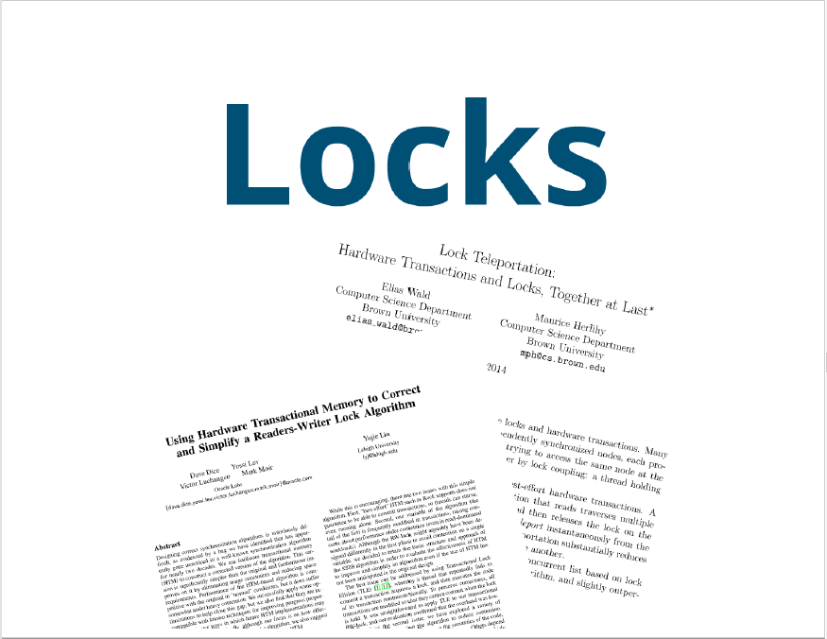
Locks and transactions complement one another

Slide 109
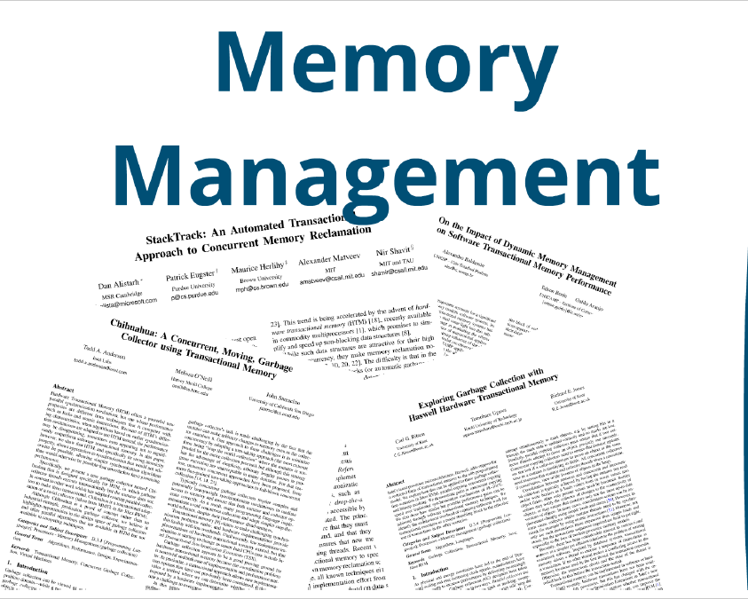
TM can improve memory management,
both automatic and explicit.

Slide 110
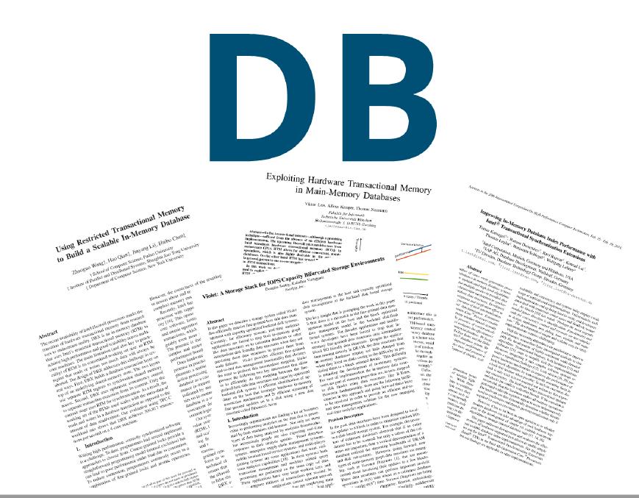
TM can restructure in-memory databases

Slide 111
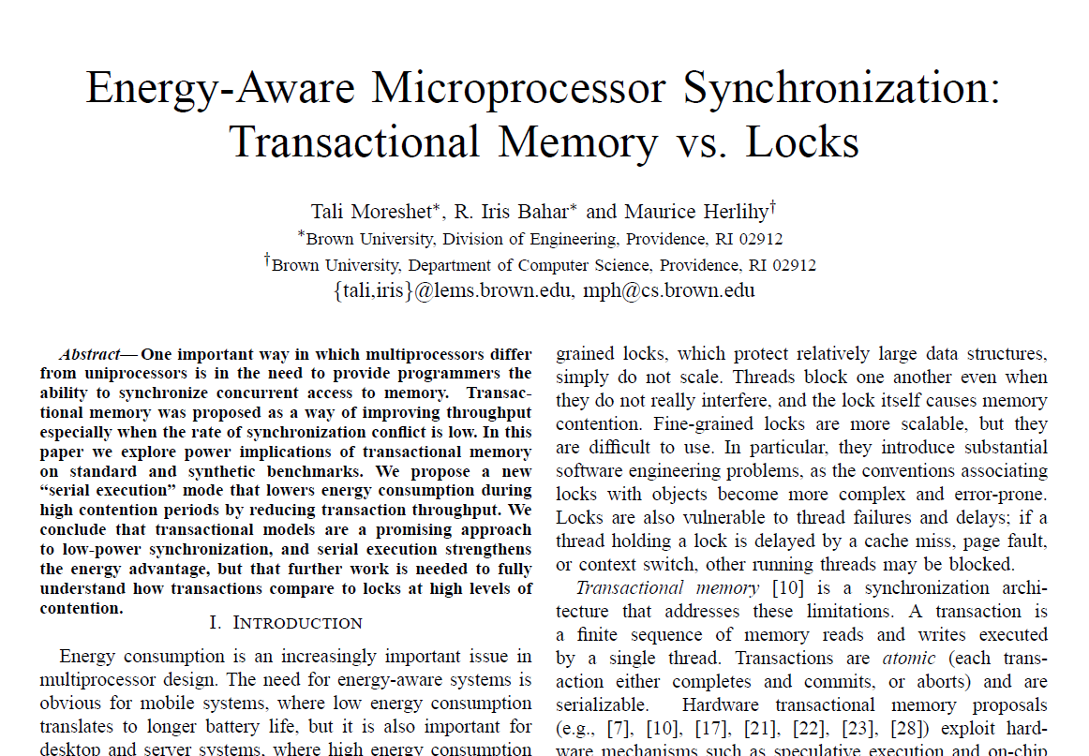
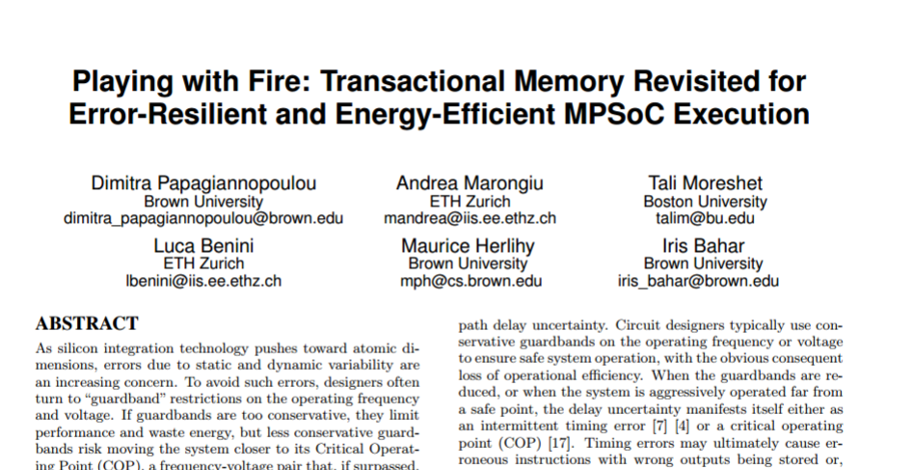
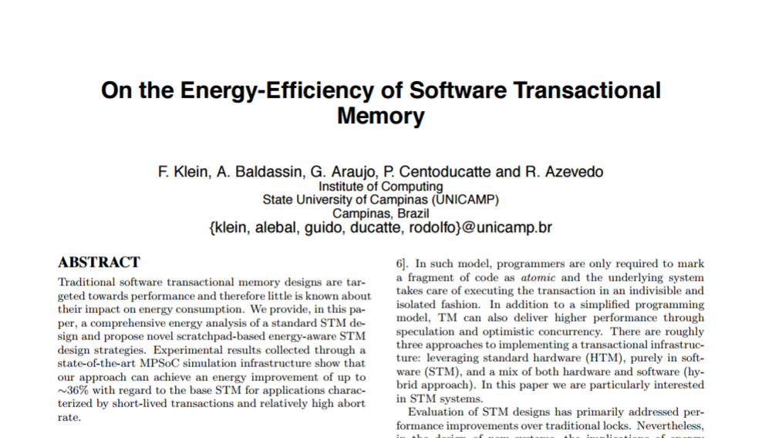
TM can be energy-efficient

Slide 112
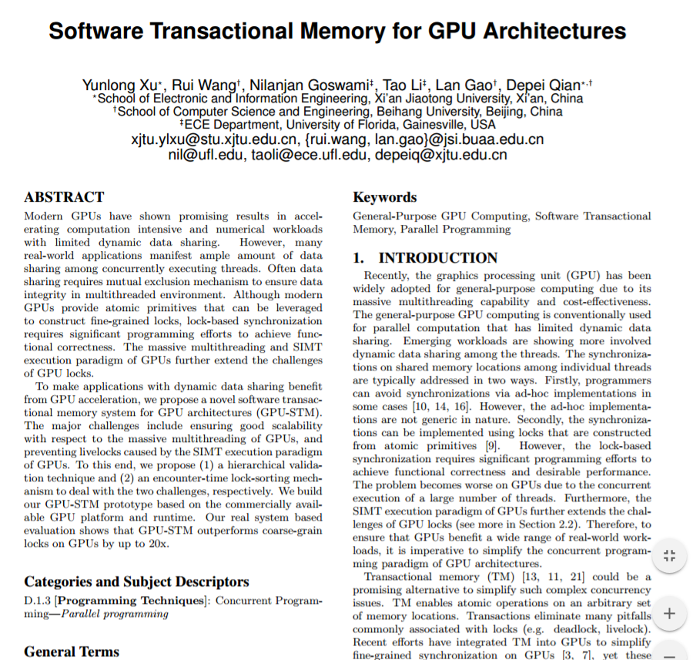
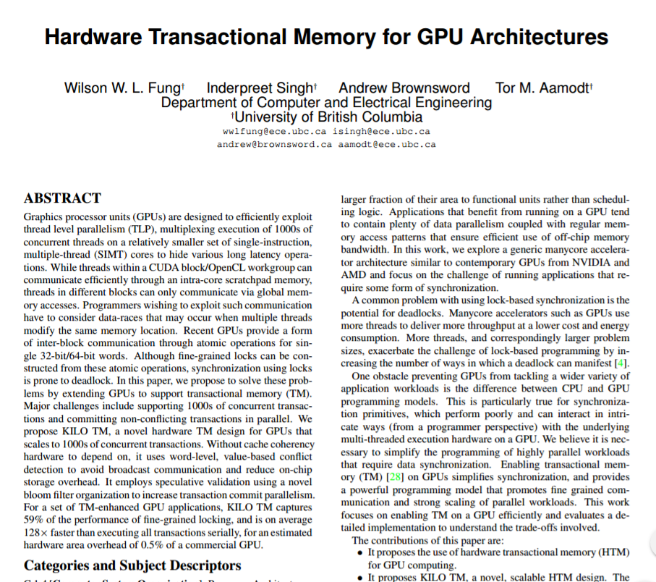
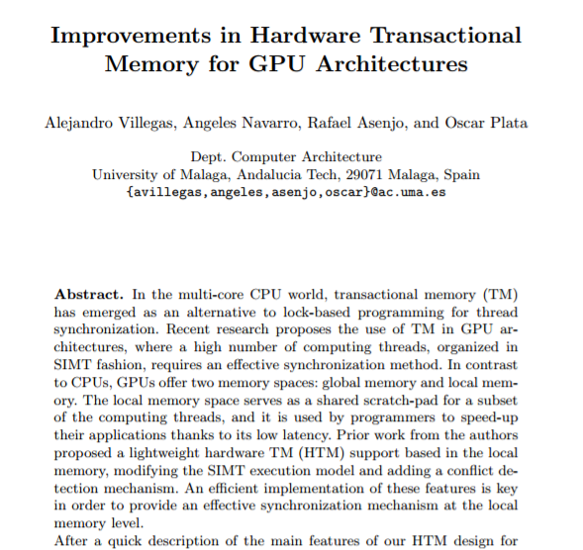
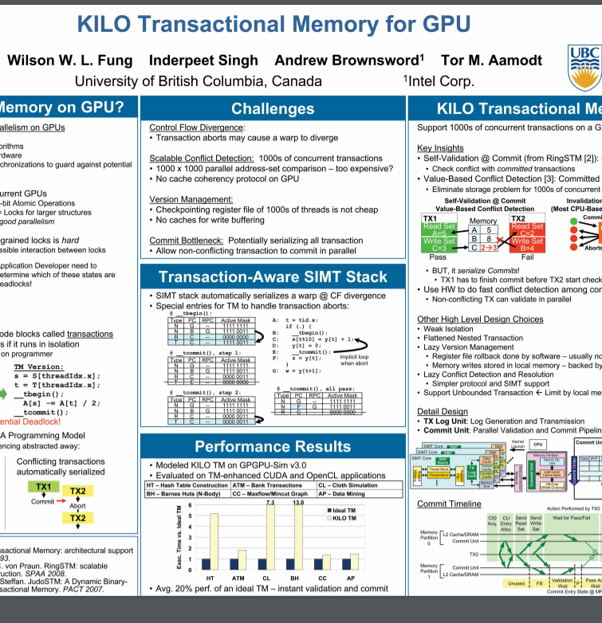
GPUs and accelerators benefit from transactions

Slide 113
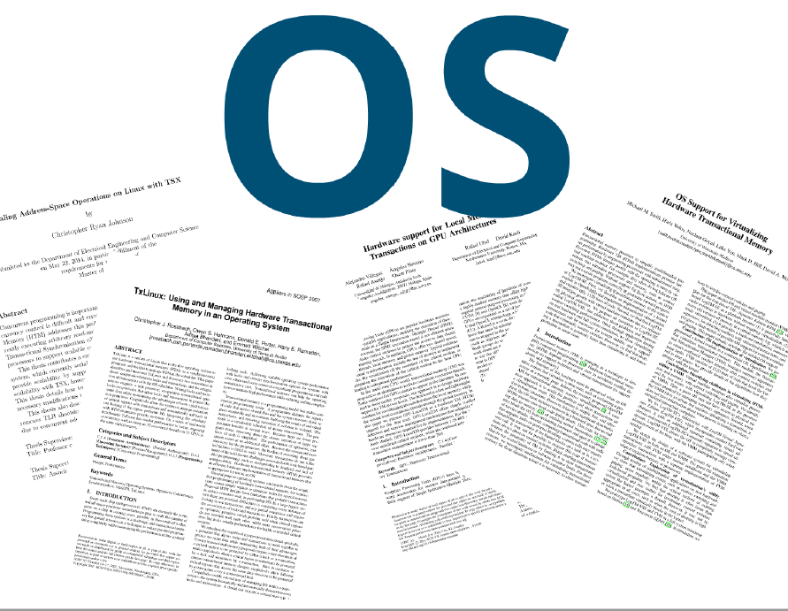
TM can simplify operating system kernels,
device drivers, security …

Slide 114
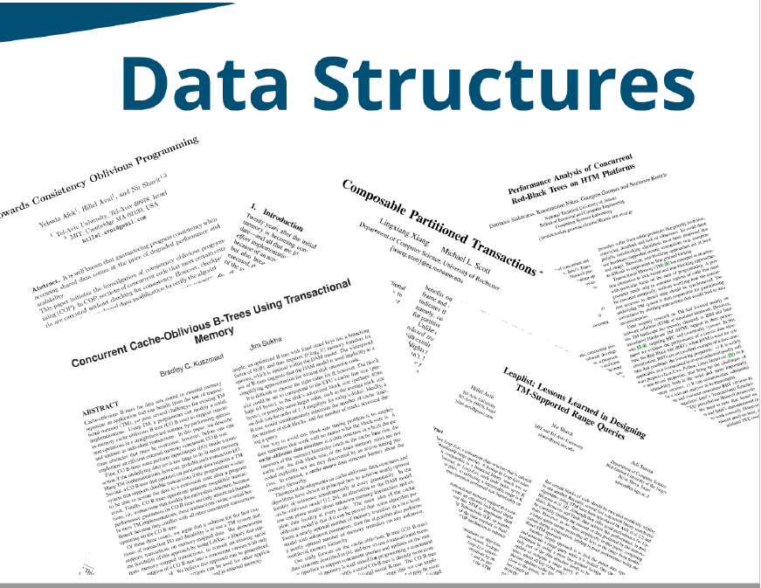
Transaction-Friendly data structures

Slide 115
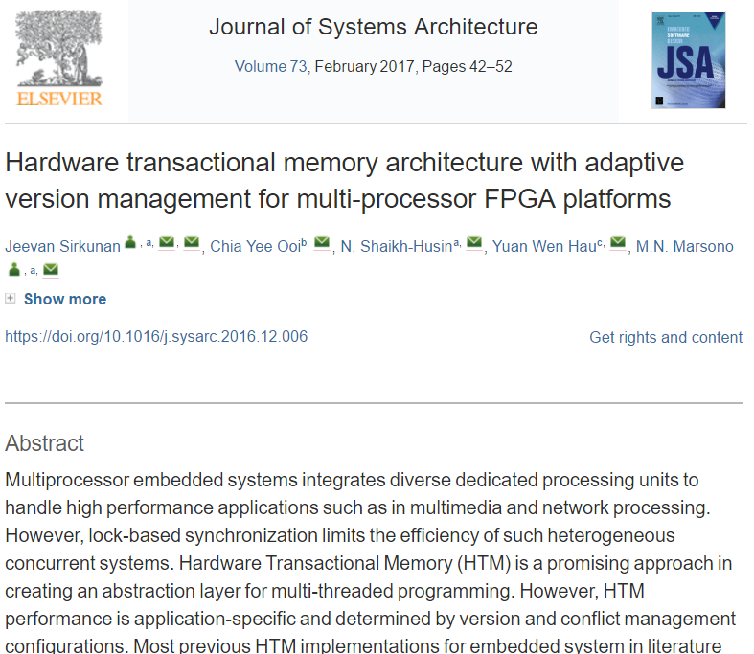
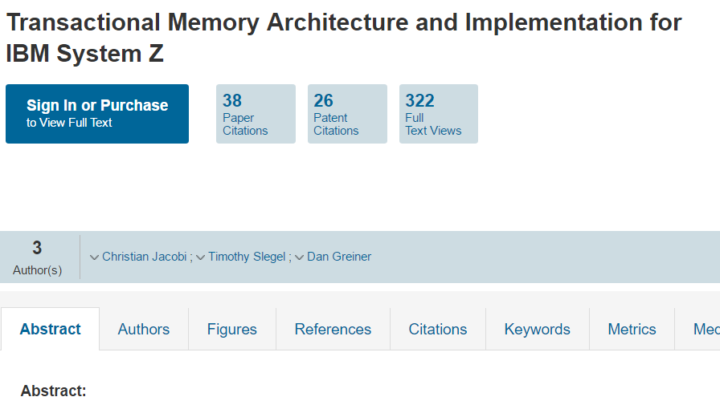
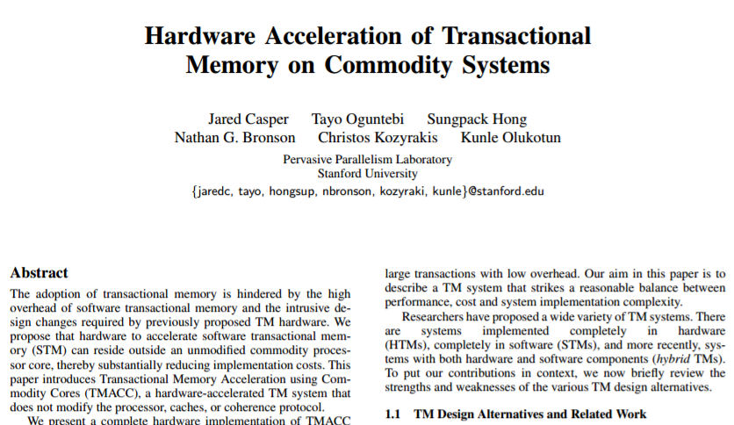
Computer Architecture Support!

Slide 116
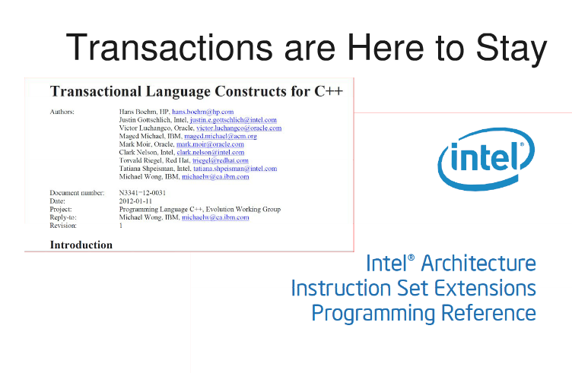

Slide 117

I, for one, Welcome our new Multicore Overlords …
Multicore makes us rethink everything
Standard approaches won’t scale
But transactions might …
Plenty more to do…
Maybe you will make the breakthrough…

Slide 118

Thanks ! תודה

Slide 119
This work is licensed under a Creative Commons Attribution-ShareAlike 2.5 License.
You are free:
  to Share — to copy, distribute and transmit the work
  to Remix — to adapt the work
Under the following conditions:
  Attribution. You must attribute the work to “The Art of Multiprocessor Programming” (but not in any way that suggests that the authors endorse you or your use of the work).
  Share Alike. If you alter, transform, or build upon this work, you may distribute the resulting work only under the same, similar or a compatible license.
For any reuse or distribution, you must make clear to others the license terms of this work. The best way to do this is with a link to
  http://creativecommons.org/licenses/by-sa/3.0/.
Any of the above conditions can be waived if you get permission from the copyright holder.
Nothing in this license impairs or restricts the author's moral rights.

